Slide 1
Regression Kriging

Slide 2
Table of contents:
Predictive modelling
Regression Kriging
Extracting covariate values
Categorical variables in modelling
Linear regression
Assumptions of linear regression
Multiple Linear Regression in R
Stepwise variable selection
Graphical diagnosis of MLR
Collinearity test, Bonferroni test
Mapping OCS using the MLR model
Kriging the residuals
Using Regression Kriging to map soil properties

Slide 3
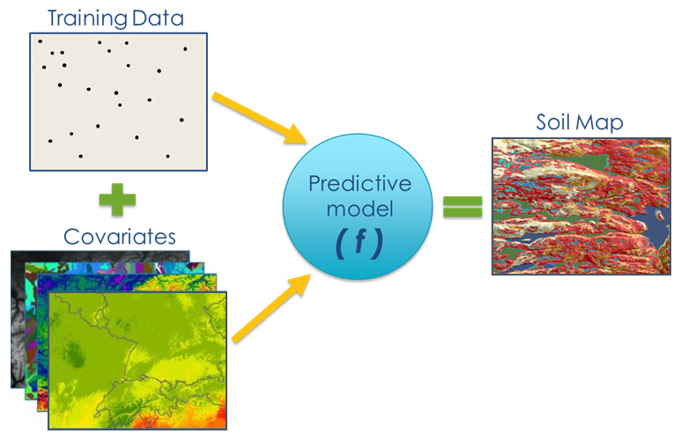
Where we stand?
pending...
Done!
Done!

Slide 4
Predictive modelling
Regression Kriging is a hybrid model with 2 components:
Multiple linear regression;
Kriging of the residuals;
Random forest is machine learning algorithm that uses a different combination of prediction factors to train multiple regression trees.

Slide 5
Regression Kriging
Regression Kriging is a spatial interpolation technique that combines a regression of the dependent variable on predictors (i.e. the environmental covariates) with kriging of the prediction residuals.
Steps of Regression Kriging:
Overlaying the point data with the dependent variable (e.g. OCS) and environmental covariates (predictors). Extracting covariate data.
Fitting multiple regression model using the table that contains data from dependent variable and predictors.
In particular cases, stepwise multiple linear regression (MLR) can be used to eliminate insignificant predictors.
Kriging of the residuals (prediction errors): the regression model produces the residuals which we need to krige and add to the model predictions.

Slide 6
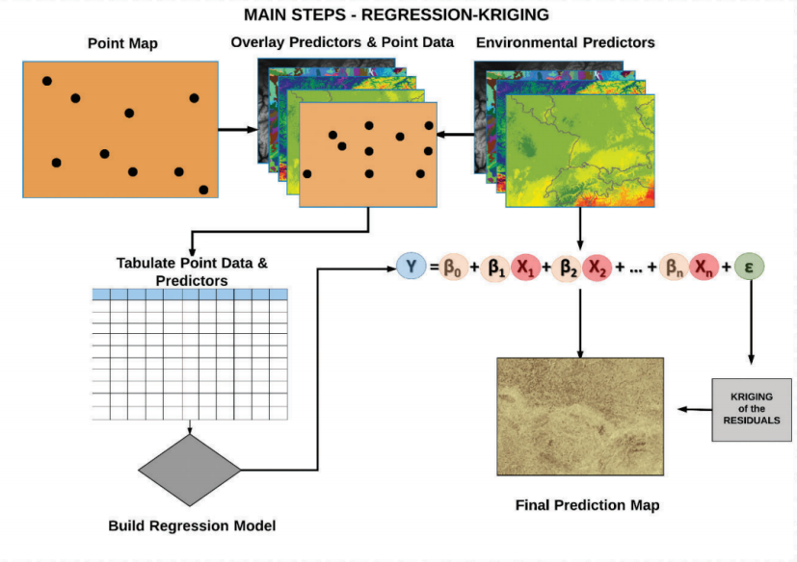

Slide 7
Let’s get started!
# Set working directory
setwd("C:/Users/hp/Documents/FAO/EduSoils/AFACI_training/Training_material")
# Load the covariates stack.
load(file = "02-Outputs/covariates.RData")
names(covs)
# Load the processed data for digital soil mapping.
dat <- read.csv("02-Outputs/dat_train.csv")
names(dat)

Slide 8
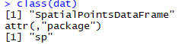
Extracting covariate values
library(sp)
class(dat)
# Promote to spatialPointsDataFrame and set the coordinate system
coordinates(dat) <- ~ X + Y
proj4string(dat) = CRS("+init=epsg:4326") # WGS84
class(dat)

Slide 9
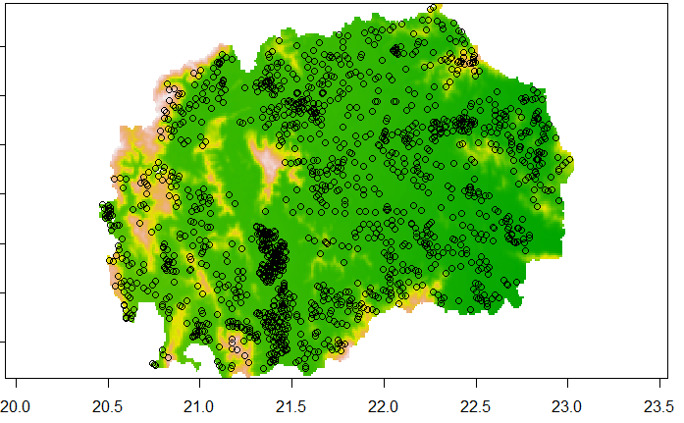
Extracting covariate values
# Check if the points overlay with covariates
plot(covs$B04CHE3)
points(dat)

Slide 10
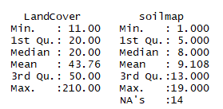
Extracting covariate values
# extract values from covariates to the soil points
dat <- extract(x = covs, y = dat, sp = TRUE)
summary(dat)
# Remove NA values
dat<-as.data.frame(dat)
dat <- dat[complete.cases(dat),]

Slide 11
Categorical variables in modelling
Continuous variables
Represent values (e.g. carbon content, elevation, temperature)
Data type in R: numeric
Can be used for arithmetical operations (+,-,*,/, etc.)
Numeric logic:
2 = 2 : TRUE
1 != 3 : TRUE
1 < 2 : TRUE
3 > 1 : TRUE
3 - 2 = 1 : TRUE
Categorical variables
Represent classes (e.g. soil types, land cover classes)
Data type in R: factor
Cannot be used for arithmetical operations (+,-,*,/, etc.)
Factor logic:
2 = 2 : TRUE
1 != 3 : TRUE
1 < 2 : FALSE
3 > 1 : FALSE
3 - 2 = 1 : FALSE

Slide 12
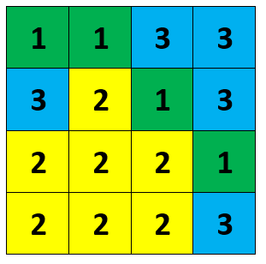
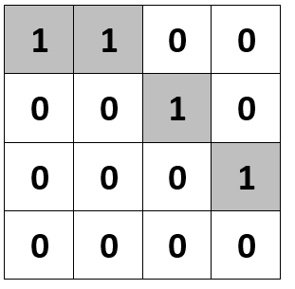
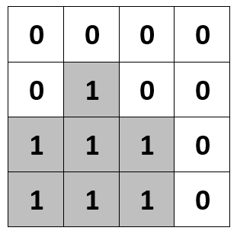
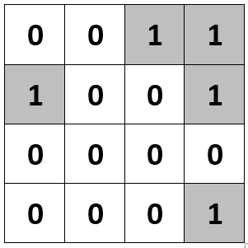
Categorical variables in modelling
1 - Forest 2 - Cropland 3 - Grassland
Conversion to binary layers (dummies)
1 - Forest, 0 - Not forest
1 - Grassland, 0 - Not grassland
1 - Cropland, 0 - Not cropland

Slide 13
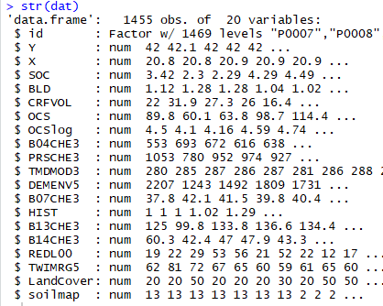
Checking data types
str(dat)
dat$LandCover <- as.factor(dat$LandCover)
dat$soilmap <- as.factor(dat$soilmap)

Slide 14
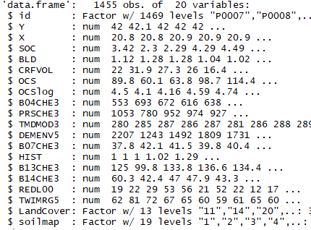
Saving the regression matrix
str(dat)
# save the final table (regression matrix)
write.csv(dat, "02-Outputs/SOC_RegMatrix.csv", row.names = FALSE)

Slide 15
Linear regression
Simple linear regression is a statistical method that allows us to summarize and study relationships between two continuous (quantitative) variables:
variable X, is regarded as the independent/predictor, explanatory, or variable.
variable Y, is regarded as the response, outcome, or dependent variable.
The goal is to build a mathematical formula that defines Y as a function of the X variable.
Once, we built a statistically significant model, it’s possible to use it for predicting future outcome on the basis of new X values.

Slide 16
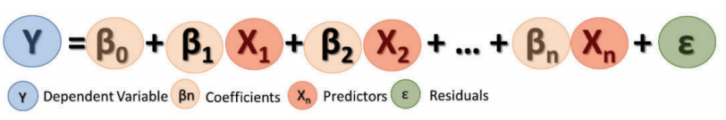
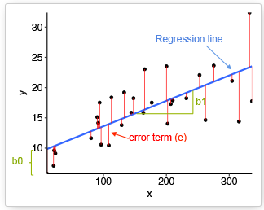
Linear regression
The mathematical formula of the linear regression can be written as follow:
Graphical representation:
the best-fit regression line is in blue
the intercept (b0) and the slope (b1) are shown in green
the residuals (errors) - e are represented by vertical red lines

Slide 17
Multiple linear regression
Dependent variable Y: which is to be predicted from a given set of predictors (e.g. organic carbon stocks).
Independent variables X’s (Predictors): which influence or explain the dependent variable (сovariates)
Coefficients β: values, computed by the multiple regression, reflect the relationship and strength of each independent variable to the dependent variable
Residuals ε: The portion of the dependent variable that cannot be explained by the model; the model under/over predictions.

Slide 18
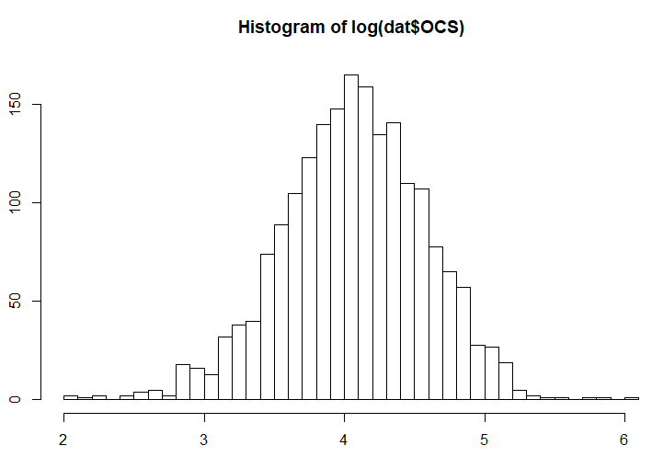
Assumptions of linear regression
Linear regression models with standard estimation techniques make a number of assumptions about the predictor variables, the response variables, and their relationship. We must review the assumptions made when using the model.
Before proceeding with the regression analysis, it is advisable to inspect the histogram of the dependent/target variable, in order to see if it has normal distribution or it needs to be transformed before fitting the regression model.
Our data is already log-transformed

Slide 19
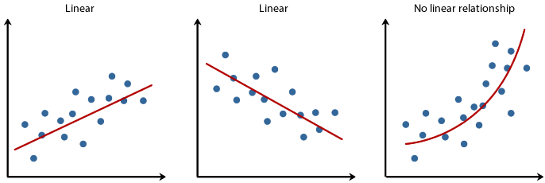
Assumptions of linear regression
Linearity Assumption: The mean value of Y for each specific combination of the X’s is a linear function of the X’s.
In practice this assumption can virtually never be confirmed, because most relationships in nature are non-linear.
Fortunately, multiple regression procedures are not greatly affected by minor deviations from this assumption. If curvature in the relationships is evident, you may consider transforming the variables.
Linear
Linear
Non-Linear

Slide 20
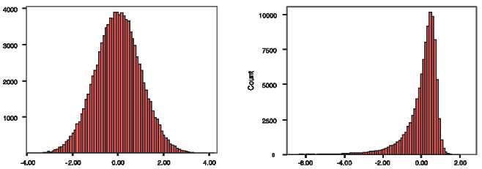
Assumptions of linear regression
Normality Assumption: It is assumed in multiple regression that the residuals (prediction errors) are distributed normally.
You can produce histograms of the residuals or Q-Q plots, in order to inspect the distribution of the residual values.
Normal
Not normal

Slide 21
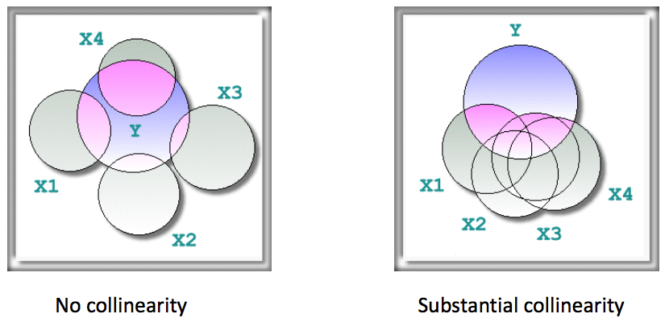
Assumptions of linear regression
Collinearity Assumption: It is assumed that independent variables (Xs) are not highly correlated with each other.
This assumption is tested using Variance Inflation Factor (VIF) values.

Slide 22
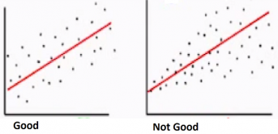
Assumptions of linear regression
Homoscedasticity Assumption: The variance of error terms is constant for all combinations of X’s. The term homoscedasticity means same scatter.
A scatter plot of standardized residuals versus predicted values can show whether points are equally distributed across all values of the independent variables.

Slide 23
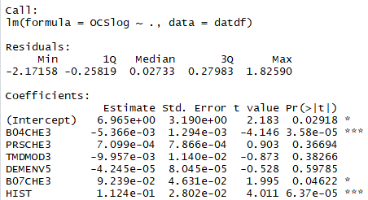
Multiple Linear Regression in R
# prepare the table for regression (only OCSlog and the covariates)
datdf <- dat[, c("OCSlog", names(covs))]
# Fit a multiple linear regression model
model.MLR <- lm(OCSlog ~ ., data = datdf)
summary(model.MLR)

Slide 24
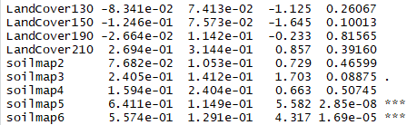
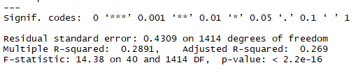
Multiple Linear Regression in R
Note that factor variables were turned into dummies:
Note significance codes and model statistics:

Slide 25
Characteristics of the model
R-squared (R²) is the percentage of variation in the dependent variable that is explained by the model. It ranges between 0 and 1 (0% to 100%).
The higher the R² value is, the better the model fits your data.
R² increases when additional predictors are added in the model.
Adjusted R² increases only when the new variable actually has a significant effect on the predicted value.
P-value is the measure of statistical significance of the model
To determine whether the model is statistically significant, compare the p-value to your significance level (usually, a significance level of 0.05 works well)
p-value ≤ significance level: The relationship is statistically significant. You may proceed with modelling.
p-value > significance level: The relationship is not statistically significant. You may need a new model.

Slide 26
Characteristics of the model
Questions:
What is the R² of the model?
Is it high or low?
What is the p-value of the model?
Is the model statistically significant or not?
Are all the predictors significant?

Slide 27
Stepwise variable selection
There were many insignificant predictors in the model. Let’s try to optimise the model using stepwise procedure
Stepwise regression can be achieved either:
by trying out one independent variable at a time and including it in the regression model if it is statistically significant,
or by including all potential independent variables in the model and eliminating those that are not statistically significant,
or by a combination of both methods.
At each step, the significance is tested, using F-tests, t-tests, adjusted R squared or other methods;
The goal is to find a set of independent variables which significantly influence the dependent variable in the linear model.

Slide 28
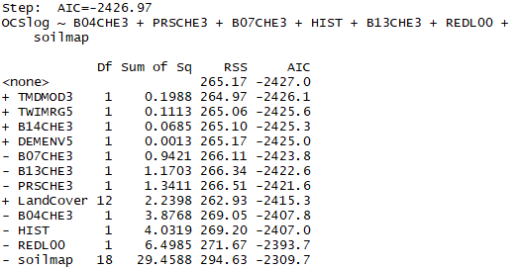
Stepwise MLR
# stepwise variable selection
model.MLR.step <- step(model.MLR, direction="both")

Slide 29
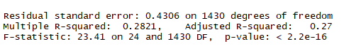
Stepwise MLR
# summary of the new model using stepwise covariates selection
summary(model.MLR.step)
Questions:
Is the R² higher or lower than before stepwise selection?
Is the adjusted R² higher or lower than before?
Is the model statistically significant?

Slide 30
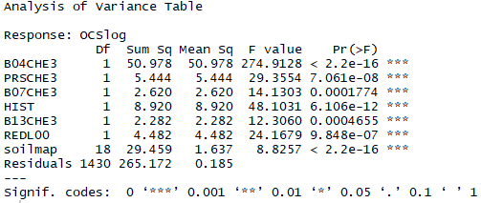
Stepwise MLR
# analysis of variance (anova) of the new model
anova(model.MLR.step)

Slide 31
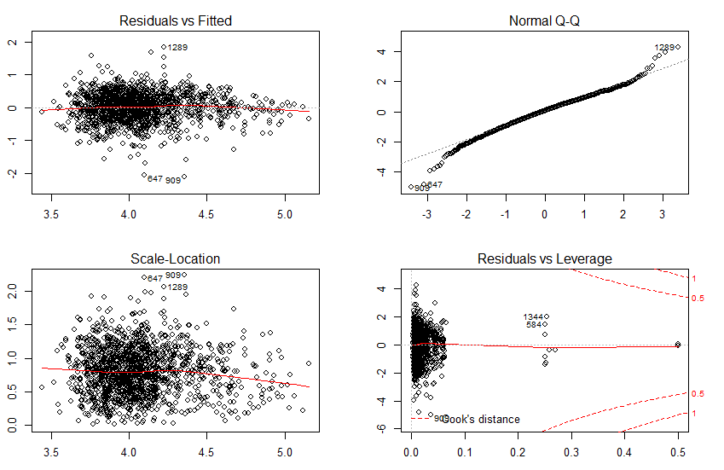
Graphical diagnosis of MLR
# graphical diagnosis of the regression analysis
par(mfrow=c(2,2))
plot(model.MLR.step)
par(mfrow=c(1,1))

Slide 32
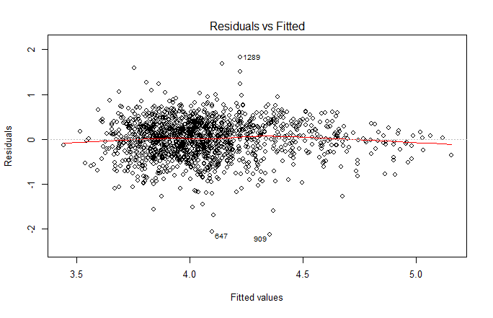
Residuals vs Fitted
This plot shows if residuals have non-linear patterns.
If you find equally spread residuals around a horizontal line without distinct patterns, that is a good indication you don’t have non-linear relationships.

Slide 33
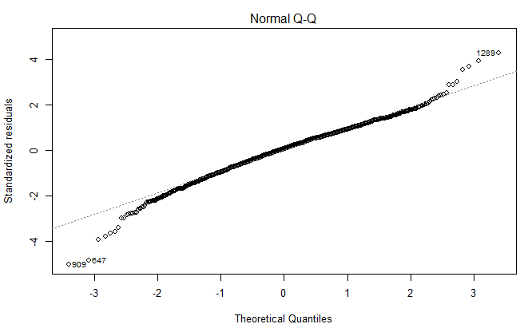
Normal Q-Q plot
This plot shows if residuals are normally distributed (checking normality assumption)
It’s good if residuals are lined well on the straight dashed line.

Slide 34
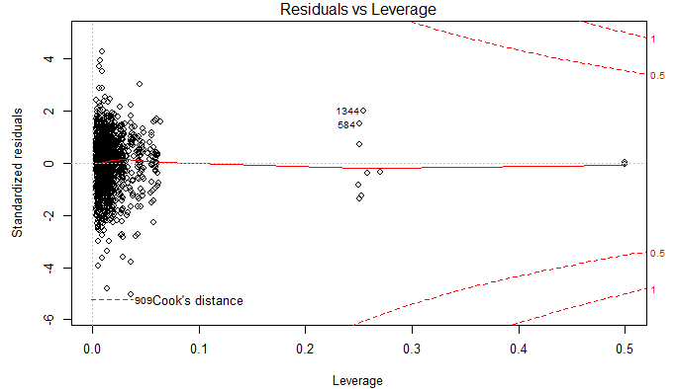
Residuals vs Leverage
This plot helps us to find influential cases (outliers that greatly affect the model) if any.
We watch out for outlying values at the upper right corner or at the lower right corner.

Slide 35
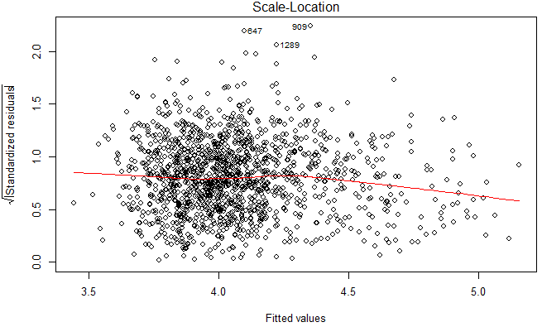
Scale-Location plot
This plot shows if residuals are spread equally along the ranges of predictors (checking homoscedasticity assumption).
It’s good if you see a horizontal line with equally (randomly) spread points.

Slide 36
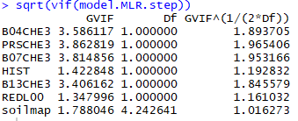
Collinearity test
# collinearity test using variance inflation factors
library(car)
vif(model.MLR.step)
# problematic covariates should have
# sqrt(VIF) > 2
sqrt(vif(model.MLR.step))
# Removing a layer from the stepwise model
# model.MLR.step <- update(model.MLR.step, . ~ . - PRSCHE3)

Slide 37
Mapping OCS using the MLR model
After thoroughly checking the model, we can use it for prediction;
We predict the OCSlog values for all unknown locations using our model and covariates;
# Make a prediction across all Macedonia using linear model
pred <- predict(covs, model.MLR.step)
Object ‘pred’ is a raster with predicted OCSlog across all the the country
Now, we need to back-transform it from log to OCS (t/ha)
# Back transform predictions log transformed
pred <- exp(pred)

Slide 38
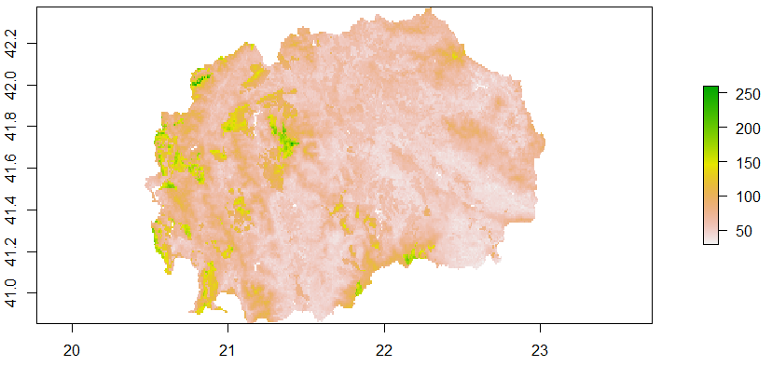
Explore and save the MLR map
# Explore and save the result as a tiff file
plot(pred)
writeRaster(pred, filename = "02-Outputs/MKD_OCS_MLR.tif",
overwrite=TRUE)

Slide 39
Regression step finished
We created our first map using predictions of multiple linear regression!
However, the model is not perfect: it still contains residuals (difference between predicted and observed value),
If the residuals are autocorrelated (have a spatial pattern), then the map can be further improved by adding a kriging step.
Next step - kriging!

Slide 40
Regression Kriging
Kriging residuals

Slide 41
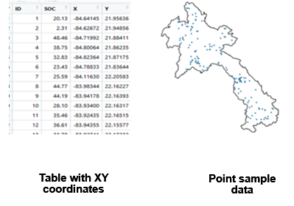
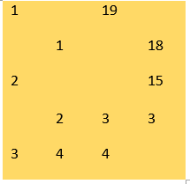
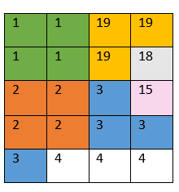
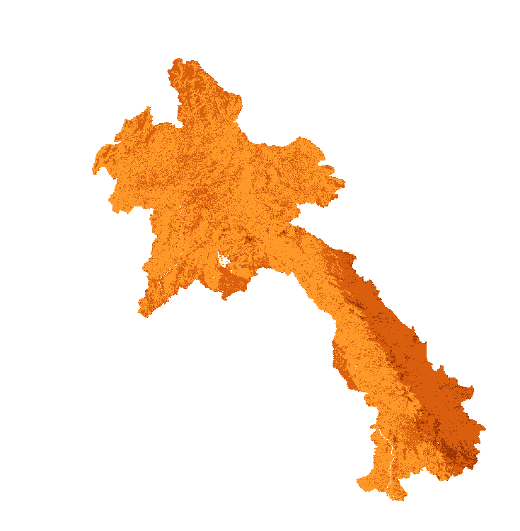
Interpolation
In digital soil mapping we mostly work with data in table format and then rasterize this data so that we can make a continuous map
Interpolation predicts values for cells in a raster from a limited number of sample data points
Modelling/Mapping
?
?

Slide 42

Spatial data is special
Geographer Waldo R. Tobler’s stated in the first law of geography:
“Everything is related to everything else, but near things are more related than distant things.”
This is at the bases of spatial autocorrelation
Housing prices are a good example of this:
houses in fancy neighborhoods tend
to have similar prices

Slide 43
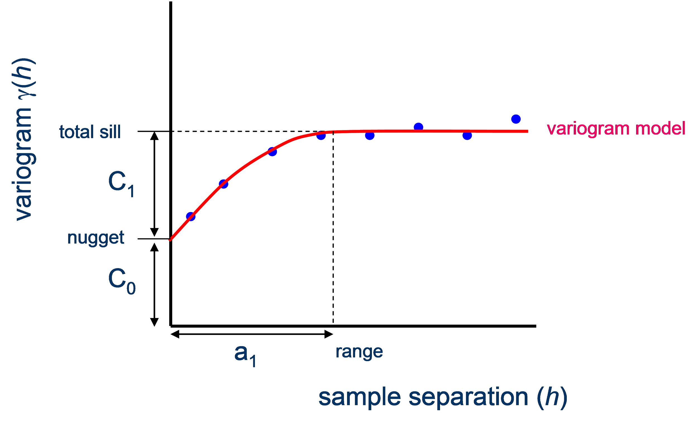
Spatial data is special
The Variogram describes the spatial dependance throughout a region
Taking into consideration spatial autocorrelation
there’s a good chance that the variance
between point A and Point C is greater
Basic assumption: Variance increases with the increasing distance between points until it becomes constant
B
C
A

Slide 44
Ordinary Kriging
In ordinary kriging predictions at unsampled locations are made based on a weighted average
It’s an interpolation technique that relies only on point observations of the target variable
Weights depend on the spatial autocorrelation structure of the variable
The weights are chosen such that the prediction error variance is minimized
To make a prediction with the kriging interpolation method, two tasks are necessary:
Uncover the dependency rules by creating a variogram and covariance functions to estimate the statistical dependence (called spatial autocorrelation) values that depend on the model of autocorrelation (fitting a model).
Make the predictions

Slide 45
Kriging
A semivariogram has three components:
Sill → describes the total variance of the process
Range → distance beyond which there’s not spatial autocorrelation
Nugget → variance at distance = 0

Slide 46
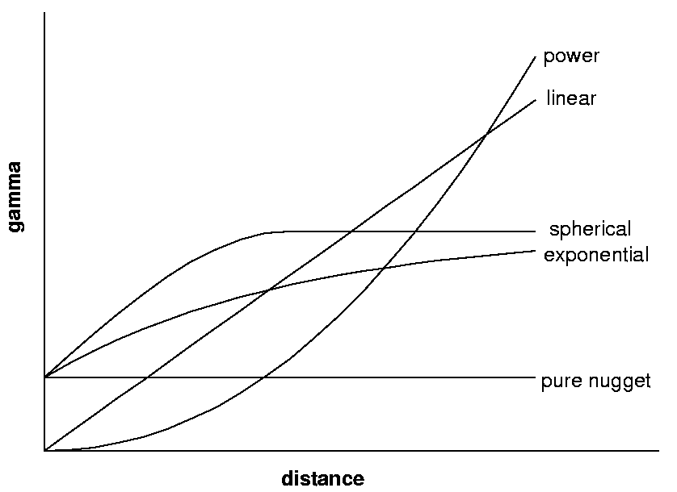
Kriging
To make predictions at unknown locations a curve needs to be fitted to the semivariogram
Abstractly, this is similar to regression analysis, in which a continuous line or curve is fitted to the data points
There are different Semivariogram-models that can be selected to better fit the data

Slide 47
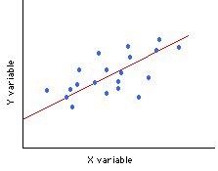
Regression Kriging
Regression kriging is a hybrid interpolation technique which combines two conceptually different approaches to modelling and mapping spatial variability:
interpolation based on regression of the target variable based on spatially auxiliary information (a.k.a covariates)
interpolation relying only on point observations of the target variable
It combines a regression of the dependent variable (target variable) on predictors (the environmental covariates) with kriging of the prediction residuals
Residual

Slide 48
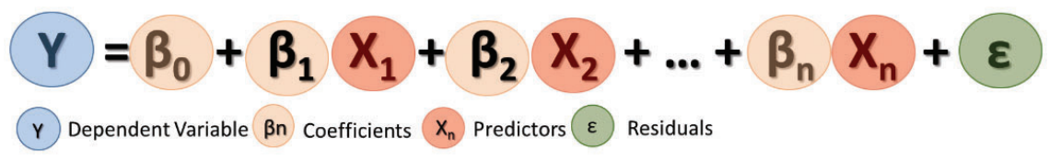
Regression Kriging
Instead of assuming the errors ε(s) are independent, you model them to be autocorrelated
The residuals show spatial autocorrelation → Semivariogram
Regression kriging is advantageous compared to ordinary kriging when:
We don’t have that many data points to predict the target variable in our study area
We know that there is a strong relationship between the target variable and the independent ones
Kriging

Slide 49
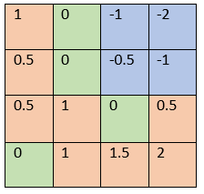
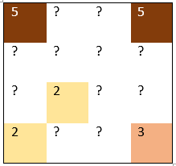
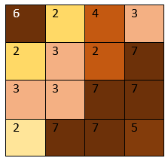
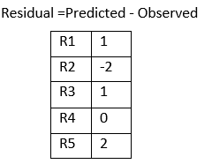
Regression Kriging
Kriging residuals of a linear model can be interpreted as creating a correction map that can be combined to the map created with the linear regression in order to take in account the autocorrelation of errors
The autocorrelation of errors can be interpreted as the way our model tends to overpredict or underpredict our target variable depending on the location
Interpolation of residuals through kriging:
Observed values:
Linear Model Prediction:

Slide 50
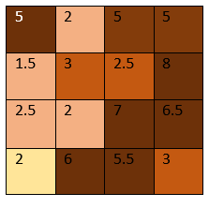
Regression Kriging
The final map is created by correcting the predictions of the linear model based on the kriged residuals
Interpolation of residuals through kriging:
Regression Kriging map:
Linear Model Prediction:

Slide 51
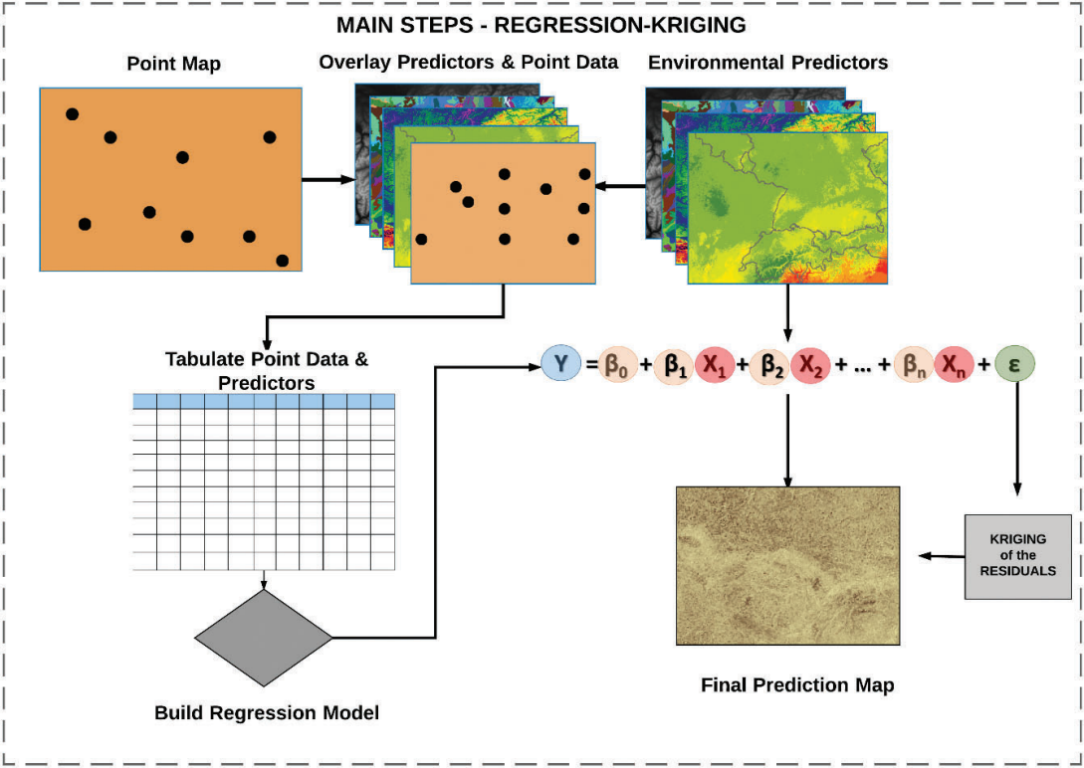
Regression Kriging Workflow
Extract the values of the covariates and target variables into the single table
Fit a multiple regression model using the previously created table
Kriging: Model the residuals taking into account spatial correlation
Done
Done
Done
Done
Pending

Slide 52
Regression Kriging
During this part of the workshop we wil:
Promote covariates to SpatialGridDataframe
Compute and explore a variogram
Create and tweak the variogram model to create the best interpolation of the residuals
Run the regression kriging model

Slide 53
SpatialGridDataframe
Unlike the SpatialPointDataframe class object, this one has a defined raster resolution
Since kriging is based on measured distances, all data should be converted to a projected coordinate systems (to meters)
# Project point data
coordinates(dat) <- ~ X + Y
proj4string(dat) = CRS("+init=epsg:4326") # WGS84
dat <- spTransform(dat, CRS("+init=epsg:6204")) # Macedonian state #coordinate system
covs <- projectRaster(covs, crs = CRS("+init=epsg:6204"),
method='ngb')

Slide 54
SpatialGridDataframe
Unlike the SpatialPointDataframe class object, this one has a defined raster resolution
# Promote covariates to spatial grid dataframe (it can take a lot #of memory)
covs.sp <- as(covs, "SpatialGridDataFrame")
covs.sp@grid
# LandCover and soilmap are categorical variables, they need to be #'factor' type
covs.sp$LandCover <-as.factor(covs.sp$LandCover)
covs.sp$soilmap <-as.factor(covs.sp$soilmap)

Slide 55
Semivariogram
To compute a variogram to check if the residual exhibit spatial autocorrelation we’re going to use the gstat package
The gstat() function creates an object that contains the necessary information to perform regression kriging
In it we’re going to input our previously created linear model
library(gstat)
# Define gstat object
gstat_data <- gstat(formula = as.formula(model.MLR.step$call$formula), data = dat)

Slide 56
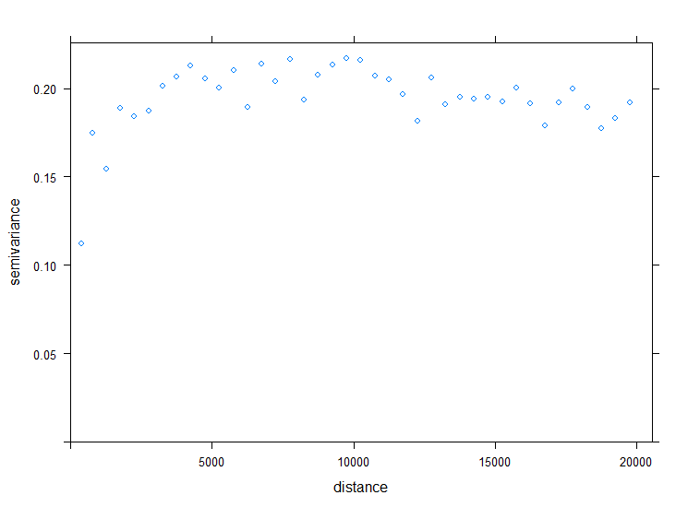
Semivariogram
Let’s plot the residuals in a semivariogram
#Compute and explore an experimental #semivariogram
vario <- variogram(gstat_data, cutoff=20000, width=500)
plot(vario, plot.nu=FALSE)

Slide 57
Semivariogram
Sill → describes the total variance of the process
Range → distance beyond which there’s not spatial autocorrelation
Nugget → variance at distance = 0
In order to predict the distribution of the residuals at locations without observed data we will create a first semivariogram model
We can tweak the nugget, sill and range

Slide 58
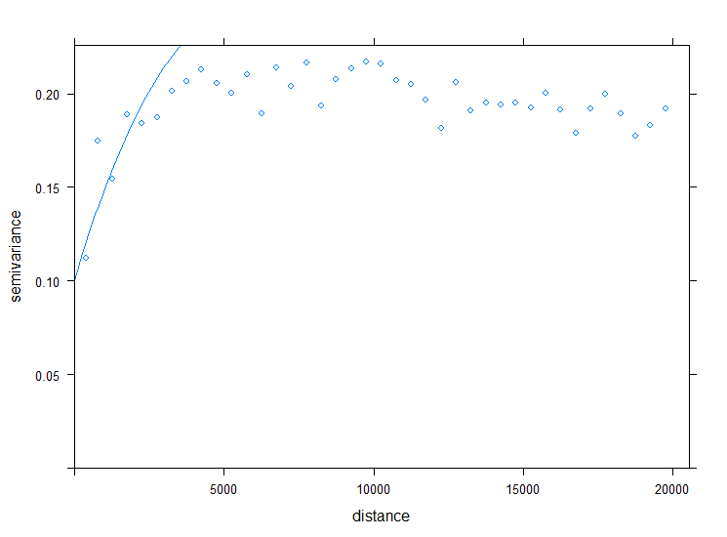
Semivariogram
In order to predict the distribution of the residuals at locations without observed data will will create a first semivariogram model
Abstractly, this is similar to regression analysis, in which a continuous line or curve is fitted to the data points
# Define initial semivariogram model
vario_mod <- vgm(nugget = 0.1, psill =
0.20, range = 5000, model = "Ste")
plot(vario, vario_mod)

Slide 59
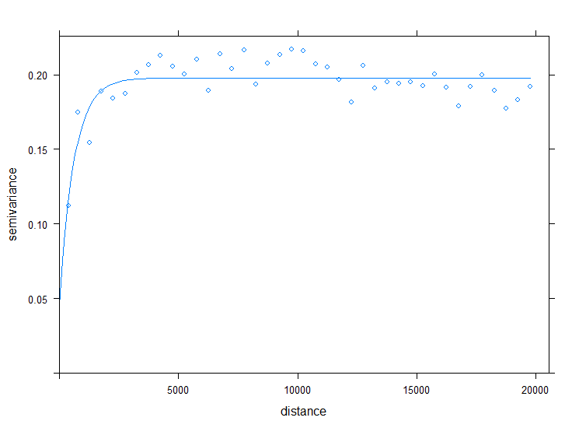
Semivariogram
Now we’re going to use the function fit.variogram() to fit the best model to predict the residuals
We had to put some initial values, for the algorithm to work
# Define the random numbers table
#(to get reproducible result)
#set.seed(12042019)
# Fit semivariogram model for kriging
vario_mod <- fit.variogram(vario,
vario_mod, fit.method=7)
plot(vario, vario_mod)
vario_mod

Slide 60
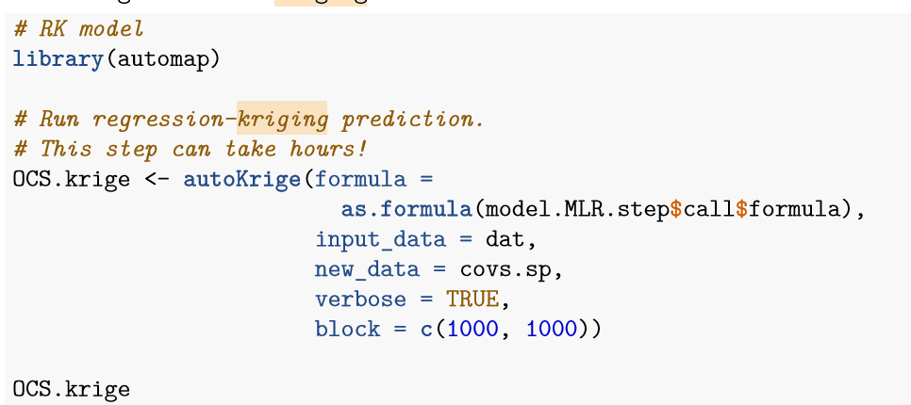
Other packages for regression kriging
The package automap fits the semivariogram model automatically to the residuals (no need to create a semivariogram graph and to tune the model)
This is the package used in the Soil Organic Carbon Mapping Cookbook 2nd Edition - FAO

Slide 61
Regression Kriging
Now we will predict our target variable using the krige() function
The formula used for the linear mode part of the final regression kriging map is the previously created step-wise linear model
The locations are defined by the XY coordinates in the object dat
The model used to krige the residual is our previously created semivariogram model
# Make a prediction across all Macedonia using Regression Kriging #model
pred_gstat <- krige(formula = as.formula(model.MLR.step$call$formula),
locations = dat,
newdata = covs.sp,
model = vario_mod,
debug.level = -1)

Slide 62
Plot our predictions
Our model was made to predict the log of the target variable therefore to we need to back transform it
# Back transform predictions log transformed
RKpred <- exp(raster(pred_gstat))
# Back transform the coordinate system to WGS 84, using MLR #prediction as a template
RKpred <- projectRaster(from = RKpred, to = covs$DEMENV5, method = "ngb")
# Explore and save the result as a tiff file
plot(RKpred)
writeRaster(RKpred,'02-Outputs/Final Maps/MKD_OCS_RK.tif', overwrite=TRUE)

Slide 63
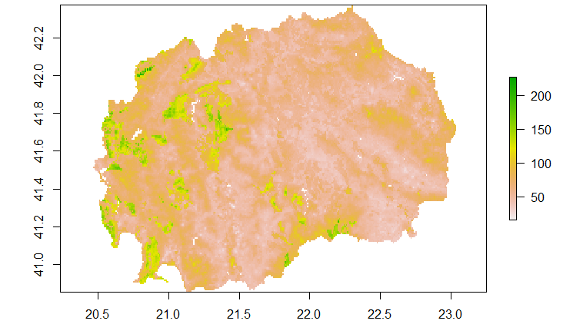
Regression Kriging

Slide 64
Uncertainty
We can display the model’s prediction variance with a standard deviation map
# Make an uncertainty estimation as a map of standard deviations
# Standard deviation is the square root of kriging variance
RKsd <- sqrt(raster(pred_gstat, layer='var1.var'))
# If data was not log-transformed, than standard deviation map is in same units as the data (t/ha) and can be reported as uncertainty map
plot(RKsd, col= topo.colors(255))
# But in our case it was calculated on log-transformed data and cannot be back transformed to t/ha
writeRaster(RKsd_log,'02-Outputs/MKD_OCS_RK_sd.tif', overwrite=TRUE)

Slide 65

Uncertainty (see lecture 8.Uncertainty and Validation)

Slide 66
Uncertainty (see lecture 8.Uncertainty and Validation)
We can calculate confidence interval from the standard deviations
# Calculate 95% confidence interval on
# log-transformed data as pred +-2*sd
RK_ci_high<-raster(pred_gstat)+2*RKsd_log
RK_ci_low<-raster(pred_gstat)-2*RKsd_log
# Confidence interval limits can be back transformed to t/ha
RK_ci_high<-exp(RK_ci_high)
RK_ci_low<-exp(RK_ci_low)
plot(RK_ci_high)
plot(RK_ci_low)
# Export limits of confidence interval as measures of uncertainty
writeRaster(RK_ci_high,'02-Outputs/MKD_OCS_RK_ci95_high.tif', overwrite=TRUE)
writeRaster(RK_ci_low,'02-Outputs/MKD_OCS_RK_ci95_low.tif', overwrite=TRUE)

Slide 67
Let’s apply this to our clay data!

Slide 68
Thank you!

